Slide 1
Fake news detection
Group-24

Slide 2
Introduction
In the digital age where fake news proliferates rapidly, our presentation explores the use of advanced NLP techniques for effective detection and differentiation of true vs. false narratives. With the rise of social media and the widespread dissemination of information, the spread of fake news has become a significant issue in society.
We harness the strengths of LSTM (Long Short-Term Memory) and Transformer models, renowned for their ability to process sequential data and large datasets, respectively, in the context of complex text analysis. We were able to get 61% accuracy for our models.
Our project aims to showcase the effectiveness and efficiency of both models in fake news detection, providing insights into their performance and potential applications in automated fact-checking.
Fake news often has characteristics such as sensational headlines, emotionally charged language, lack of credible sources, and confirmation bias.

Slide 3
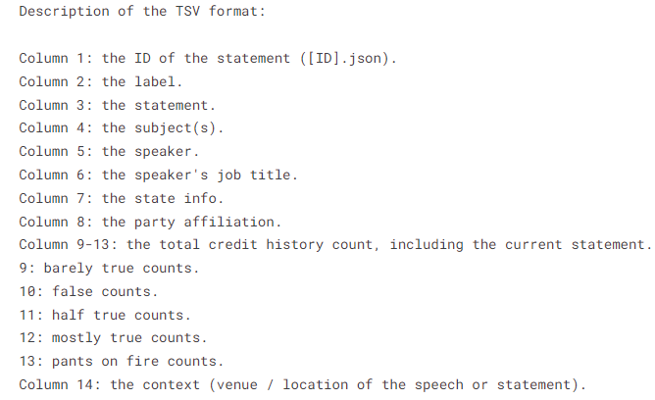
Dataset
The LIAR dataset comprises thousands of labeled statements from PolitiFact.com, a political fact-checking website. Each statement in the dataset is labeled with a truthfulness rating.
Characteristics of the LIAR Dataset
1] Size and Diversity: The dataset contains 12,800+ short statements drawn from various contexts and topics within the political domain.
2] Meta Data: The dataset includes additional metadata like the speaker's credit history, the context of the statement, and the speaker's job title which provides richer information for the model to analyze the veracity of statements.
3] Data Count:
i] Train Data – 10.2k
ii] Validation Data – 1.2k
iii] Test Data - 1.2k
Features and Labels

Slide 4
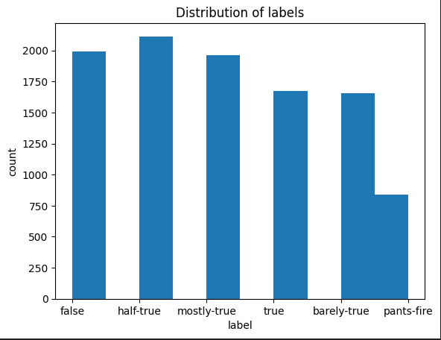
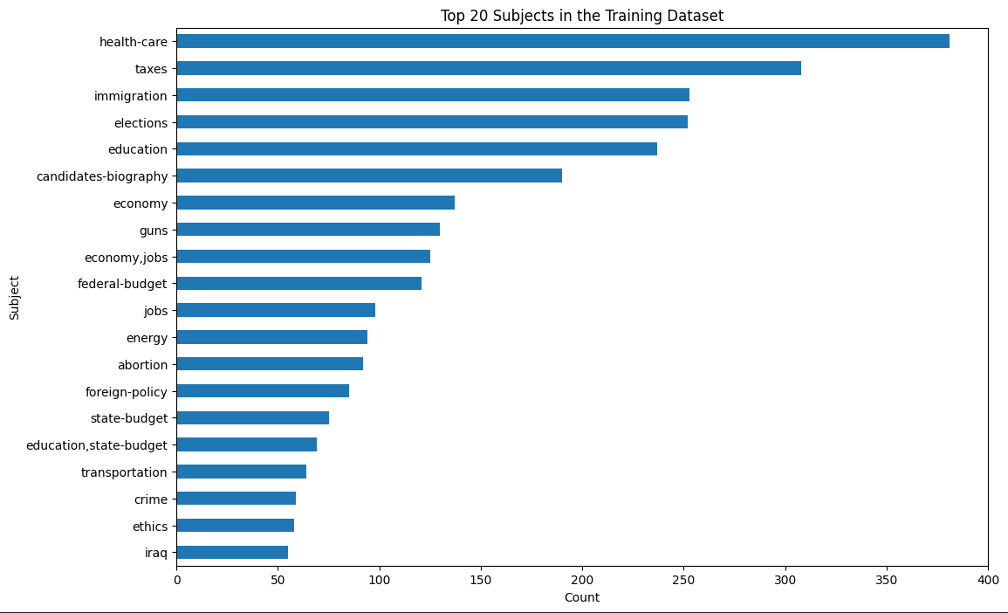
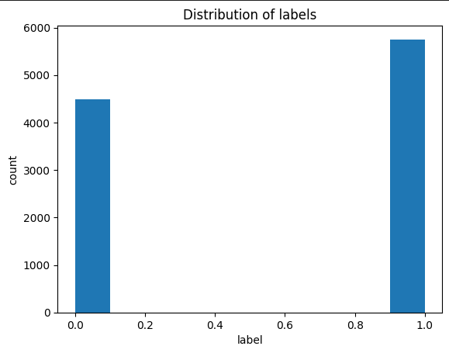
Dataset Analysis
Fig 2 - Distribution of Labels(Before Encoding)
Fig 1 - Subjects – Top 20
Fig 3 – Distribution of Labels(After Encoding)

Slide 5
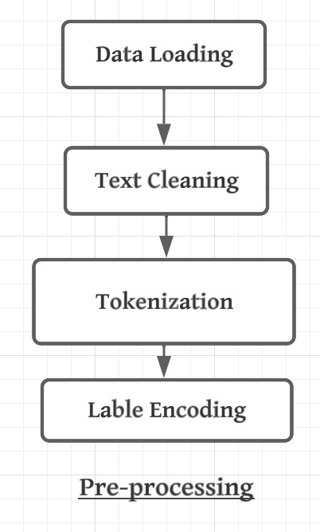
Dataset Pre-Processing
1] Data Loading:- The dataset is loaded from three separate TSV files: training data, test data, and validation data.
2] Text Cleaning:- Text cleaning is performed using regular expressions to remove unwanted patterns, URLs, HTML tags, and punctuation. Stop words are removed, and accents are normalized using the unidecode library.
3] Tokenization:- The ‘BertTokenizer’ from the transformer's library is utilized for tokenization. The tokenized sentences are then padded or truncated to a maximum length of `128`.
4] Label Encoding:- The labels are converted into binary values (1 for true news, 0 for false news).

Slide 6
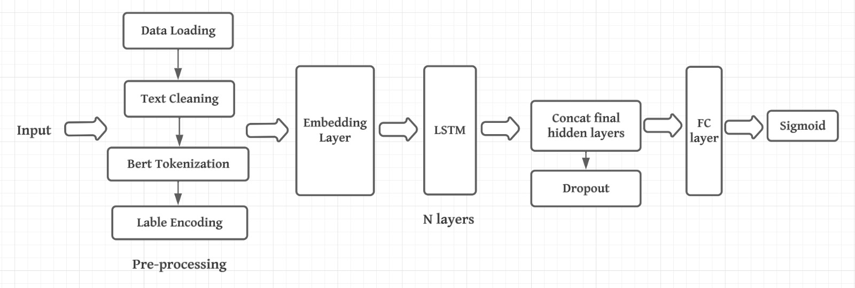
Bi-LSTM

Slide 7
Why BERT Tokenizer?
Effective OOV Handling: "BERT's sub word tokenization effectively manages Out-Of-Vocabulary words, decomposing them into familiar subunits for better model comprehension and context preservation."
Enhanced Contextual Awareness: "The BERT tokenizer's design aids BiLSTM models in capturing bidirectional context, enriching token representations with nuanced textual understanding."

Slide 8
Architecture
Bidirectional LSTM Network: "Employs a bidirectional LSTM architecture with three layers to analyze sequences, providing a deep temporal understanding by integrating information from both past and future contexts."
Embedding Layer: "Features an embedding layer that converts words into continuous vector representations, encapsulating semantic meaning."
Hidden Dimensions: "Each LSTM layer has a hidden state dimensionality of 256, offering a robust feature extraction capability."
Binary Classification: "A sigmoid activation function in the output layer facilitates binary classification, distinguishing between authentic and false news statements."
Regularization Techniques: "Incorporates dropout layers to prevent overfitting, ensuring model generalization to new data."

Slide 9
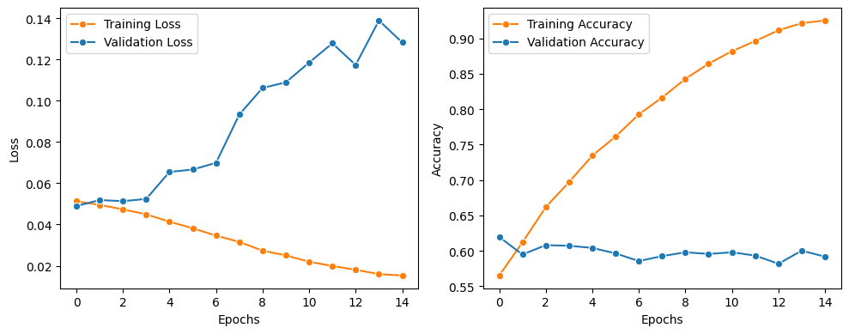
Loss Function used is Focal Loss (scaled cross entropy loss)
Optimizer is Adam
Test Accuracy is around 59%

Slide 10
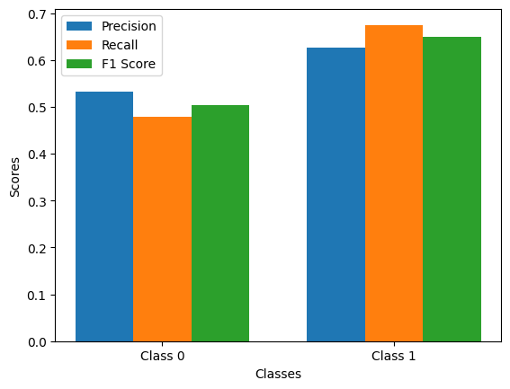
Fig: Essential Metrics

Slide 11
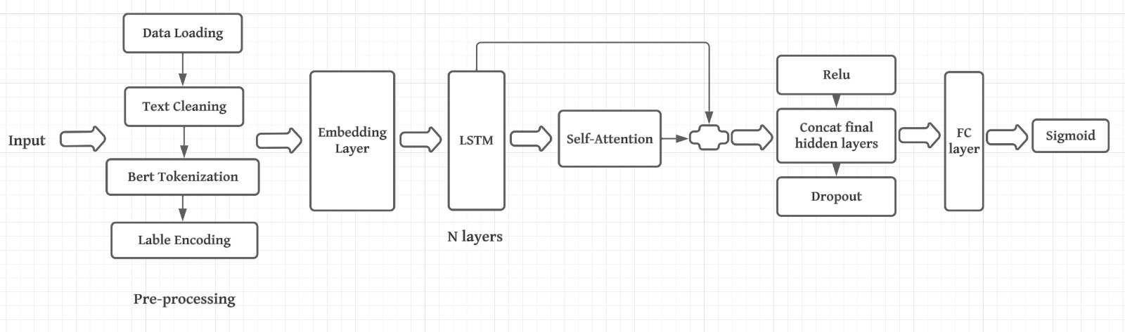
Bi-LSTM(with attention)

Slide 12
Architecture
The model architecture is structured around a bidirectional Long Short-Term Memory (LSTM) network, a potent architecture for processing sequential data. The initial embedding layer transforms discrete word indices into continuous vectors, capturing semantic relationships. Three stacked bidirectional LSTM layers with a hidden dimension of 256 facilitate comprehensive temporal understanding, extracting features from both past and future states.
The self-attention layer enhances contextual comprehension by allowing the model to dynamically prioritize relevant portions of the input sequence. Following this, a fully connected layer processes the output, and a sigmoid activation produces a binary classification output. Dropout layers between components serve as a regularization mechanism, preventing overfitting during training. The Rectified Linear Unit (ReLU) activation function introduces non-linearity, enabling the model to learn complex patterns.
This architecture collectively enables the model to effectively capture intricate contextual dependencies and make nuanced decisions in the binary classification task, distinguishing between true and false news statements on the LIAR dataset

Slide 13
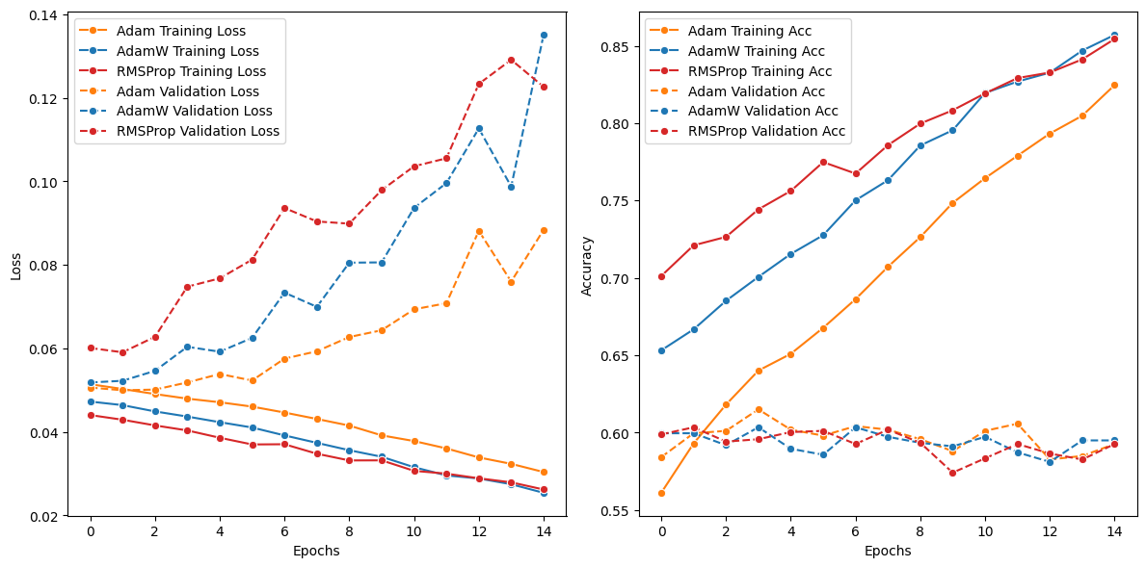
Focal Loss:

Slide 14
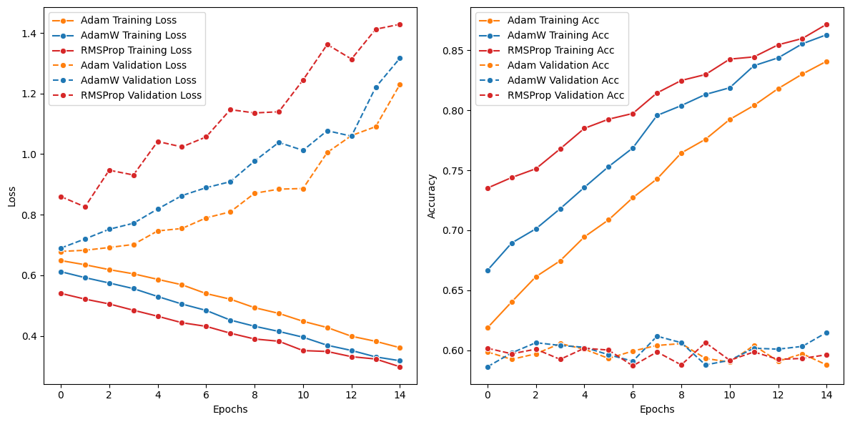
BCE Loss:

Slide 15
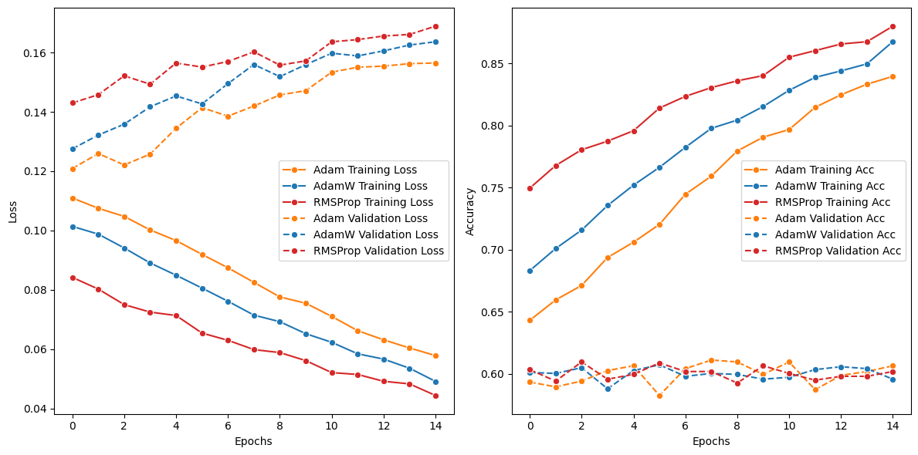
SmoothL1 Loss:

Slide 16
Accuracy:
 | Focal Loss | BCE Loss | SmoothL1 Loss
Adam | 60.2% | 62.2% | 61.01%
AdamW | 59.9% | 60.6% | 61.3%
RMSProp | 61.4% | 61.2% | 61.4%

Slide 17
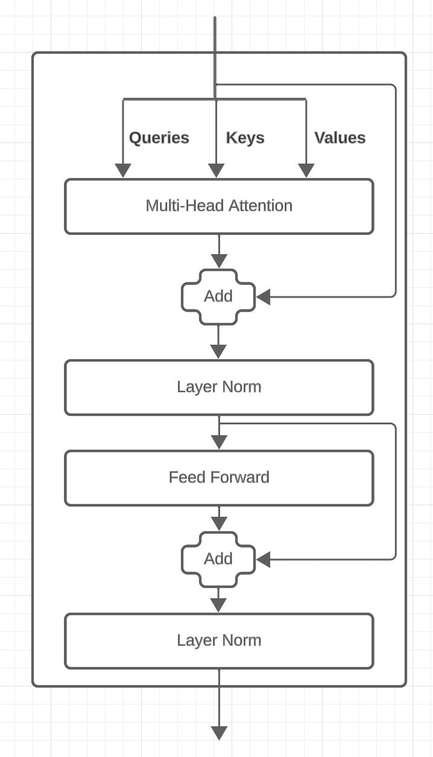
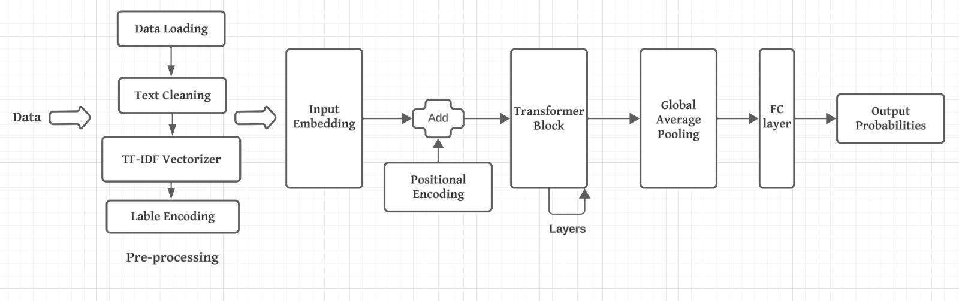
Transformer
Architecture
Transformer Block

Slide 18
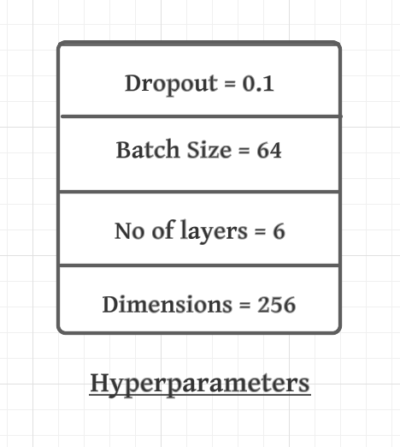
Why TF-IDF Vectorizer?
Simplicity and Computational Efficiency: TF-IDF is a simpler and more lightweight approach compared to the BERT tokenizer. It requires significantly less computational resources, making it more suitable for environments with limited processing power or for quick prototyping.
Less Prone to Overfitting: In some cases, especially with small datasets, simpler models based on TF-IDF features might generalize better and be less prone to overfitting compared to complex models like those based on BERT.
Improved Training Time: Incorporating TF-IDF might lead to faster training times for transformer models. By preprocessing the data and highlighting key features, TF-IDF can streamline the amount of information the model needs to process, leading to quicker convergence.

Slide 19
Architecture
The model begins with an Embedding Layer, which is pivotal in translating raw tokens into dense numerical vectors, laying the foundation for capturing the semantics of words. This is complemented by Positional Encoding that imbues the data with crucial sequence position information, ensuring the model retains the order of words during processing. This combination allows for a representation that is rich in semantic content and cognizant of the syntactical structure of the input sequences.
At the core of the model lie the Transformer Blocks, which employ self-attention to meticulously process the significance and context of each word relative to the entire sequence. Enhanced by Multi-Head Attention, the model can simultaneously attend to different parts of the input sequence, capturing a diverse array of contextual relationships. The subsequent Feedforward Layer further processes these attention-laden outputs to distill complex data patterns, enriching the model’s understanding of the textual nuances.
To prepare for classification, the Global Average Pooling layer efficiently condenses the rich sequence information into a fixed-size representation, which is critical for managing variable input lengths. Stability and scalability are addressed through Layer Normalization, which keeps the data within optimal ranges for learning. The culmination of these processed features occurs in the Fully Connected Layer, which synthesizes the learned information to produce a binary classification probability, distinguishing factual content from misinformation.

Slide 20
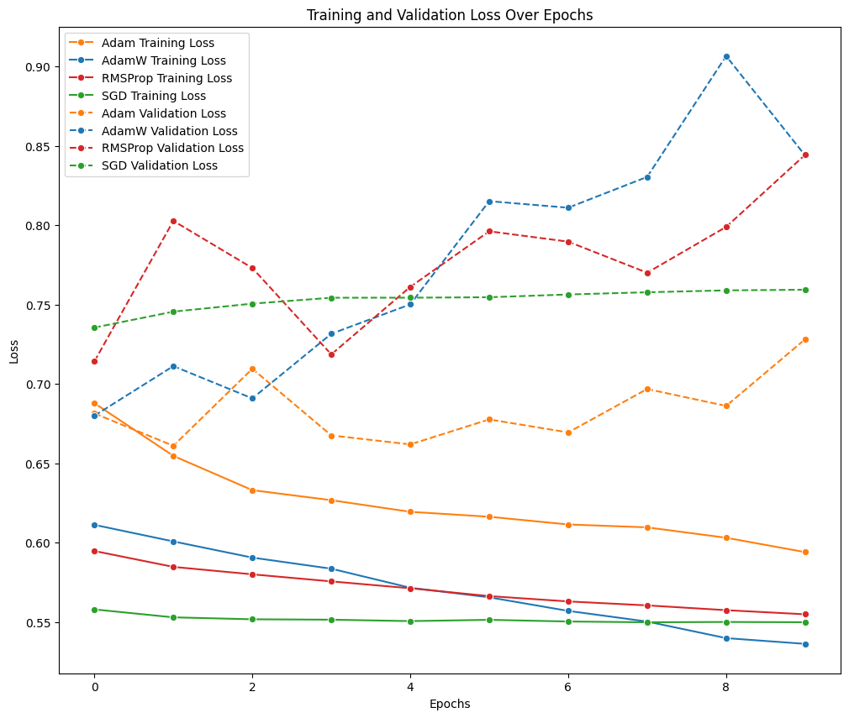
BCEWithLogitsLoss:

Slide 21
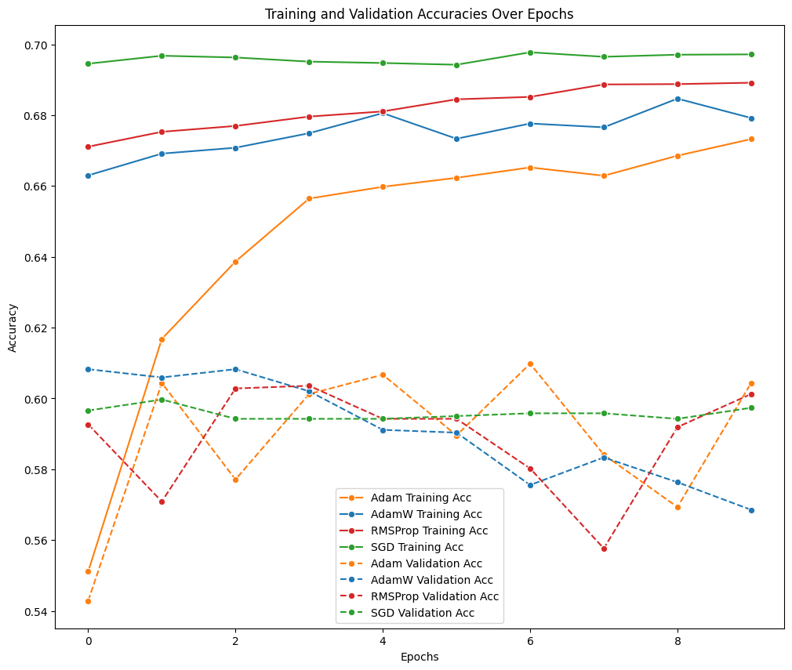

Slide 22
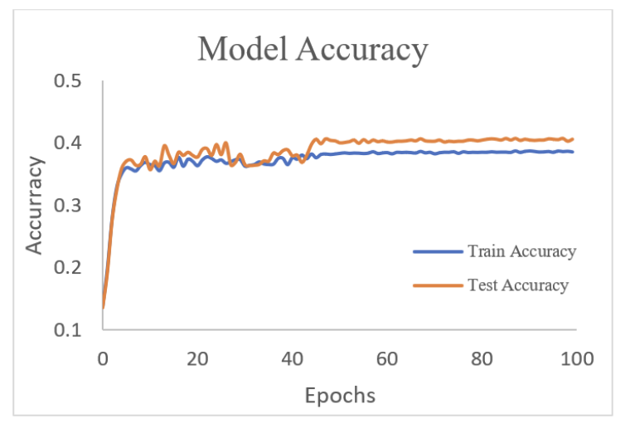
Results:
 | Adam | AdamW | RMSProp | SGD
BCEwithlogits loss | 59.8% | 59.9% | 60.2% | 60.4%
Table: Results of our transformer model for two labels.
Fig: Results from research paper for four labels.

Slide 23
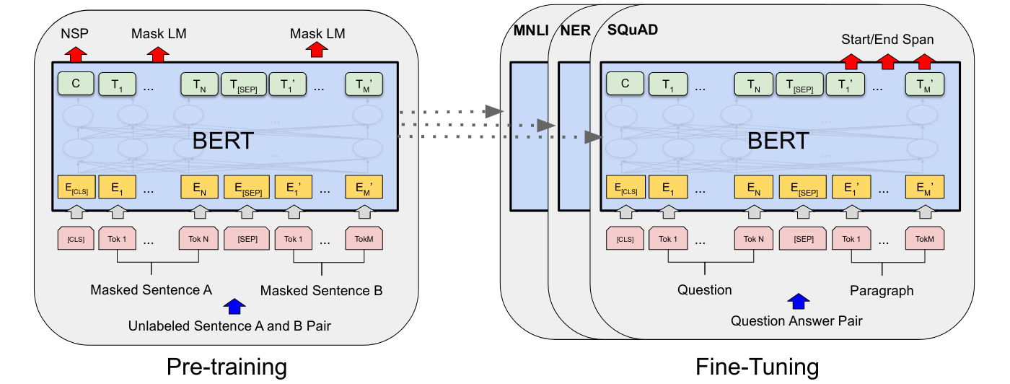
BERT:

Slide 24
We just implemented this pre-trained Bert model just to compare our models results with this model.
BERT is the first representation model based on fine tuning that outperforms numerous task-specific designs and reaches state-of-the-art performance on a wide range of sentence and token-level problems.
Here, we have two stages to complete which are pre-training and fine tuning. The model was tested on unlabelled data across several pre-training tasks during pre-training.
The pre-trained parameters are used to initialize the BERT model for fine-tuning, and labelled data from the downstream jobs is used to adjust each and every parameter.
Even the Bert model just got around 65% accuracy which is not that much higher than our models, so that we can say that our models are working well.

Slide 25
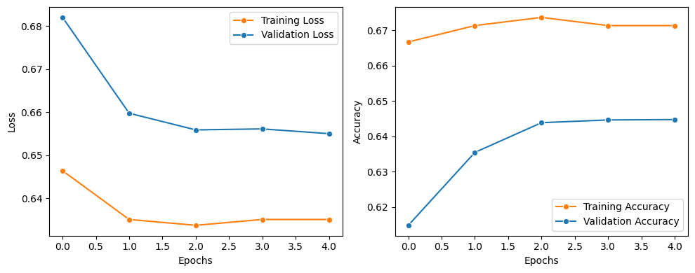
Loss Function used is BCELoss
Optimizer is Adam​W
Test Accuracy is around 65.5%​

Slide 26
Conclusion
In conclusion, the presentation adeptly illustrates the use of advanced NLP techniques, specifically LSTM and Transformer models, for fake news detection. The employment of the LIAR dataset and BERT tokenizers marks a noteworthy stride in discerning true from false narratives
Future improvements could involve improving the quality and diversity of the training dataset, including a wider range of topics and sources, can help the models learn more nuanced patterns of misinformation. Also exploring deeper learning algorithms for nuanced context understanding and implementing cross-lingual capabilities to tackle fake news in various languages, broadening the models' applicability and effectiveness globally.

Slide 27
References
https://medium.com/@cmukesh8688/tf-idf-vectorizer-scikit-learn-dbc0244a911a
https://nshrimali21.medium.com/language-translation-transformers-attention-pytorch-35641c056992
https://github.com/youngbin-ro/Attention-Based-BiLSTM
https://medium.com/@skillcate/detecting-fake-news-with-a-bert-model-9c666e3cdd9b
https://medium.com/@hunter-j-phillips/multi-head-attention-7924371d477a
https://spotintelligence.com/2023/01/31/self-attention/
https://github.com/SindhuMadi/FakeNewsDetection/tree/main
https://towardsdatascience.com/build-your-own-transformer-from-scratch-using-pytorch-84c850470dcb
https://github.com/Nish-19/BERT\_Tutorial/tree/main
https://github.com/JaySuthar/FAKE\_NEWS\_DETECTION\_USING\_CNN\_LSTM\_BILSTM\_BERT\_ROBERTA

